Slide 1


Node.js Basics P1
Vadym Makhonin
April 2017

Slide 2
AGENDA OF THE LECTURE
What is Node.js?
Blocking & Non-Blocking I/O, Event loop
Callback pattern
Module system
Overview built-in modules

Slide 3
WHAT IS
NODE.JS?

Slide 4

WHAT IS NODE.JS?
Node.js is a cross-platform JavaScript environment that uses an asynchronous event-driven model. This allows Node.js to get excellent performance based on the architectures of many Internet applications.

Slide 5
NODE.JS IN BRIEF
Server-side JavaScript
Built on V8
Evented, non-blocking I/O
CommonJS module system
8000 lines of C/C++, 2000 lines of JavaScript

Slide 6
WHAT COULD YOU BUILD?
Real-time applications(chats etc)
Data streaming applications
REST APIs
Microservices
Tooling(webpack, gulp etc)

Slide 7
WHERE NOT TO USE NODE.JS?
CPU intensive applications
Just static file server

Slide 8
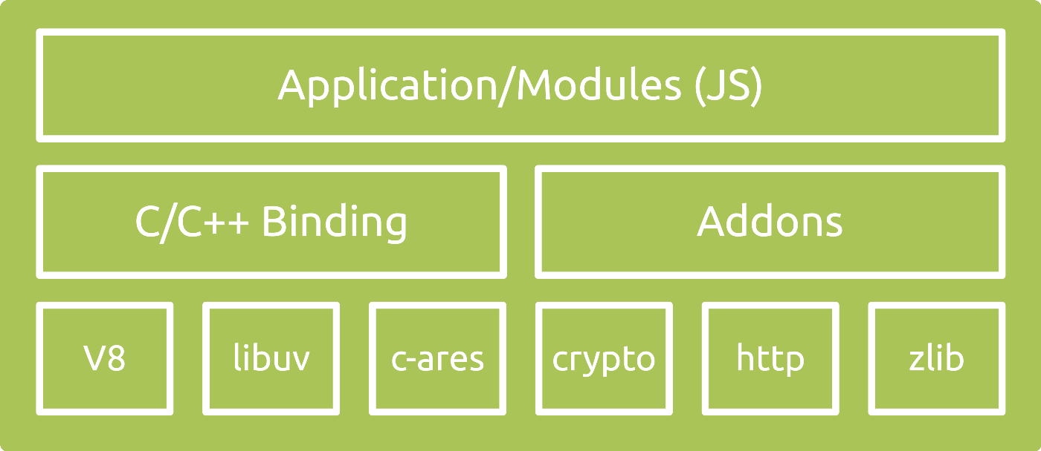
NODE.JS STRUCTURE
Notes:
https://arenli.com/architecture-of-node-js-internal-codebase-57cd8376b71f#.p6n6u0w10

Slide 9
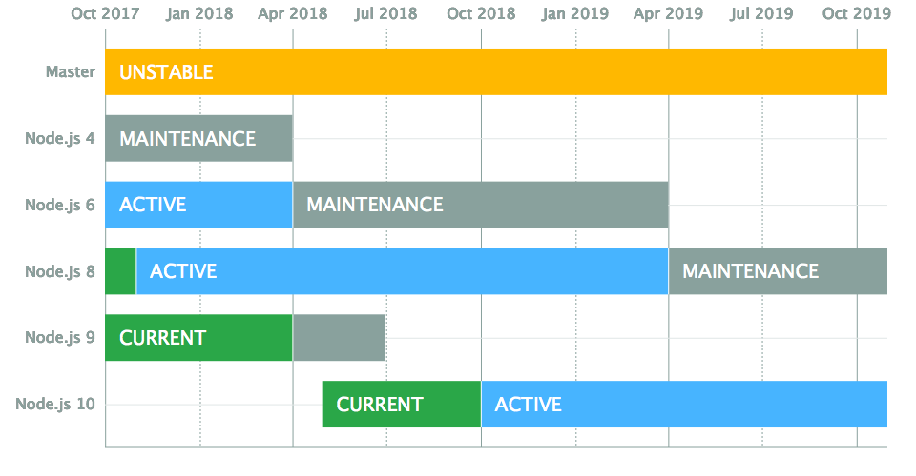
NODE.JS VERSIONING
Notes:
New release cut from master on April and October.
April releases(even) had Long Term Support
LTS - 18 month, maintenance – 12 month(only critical bugs and critical security fixes)
https://github.com/nodejs/LTS

Slide 10
NODE PACKAGE
MANAGER

Slide 11

NODE PACKAGE MANAGER (NPM)
KEY HIGHLIGHTS
It ships with Node.js installation by default
npm makes it easy for JavaScript developers to share and reuse code
makes it easy to update the code that you're sharing.
Default package manager for Node.js.
Notes:
https://www.npmjs.com/

Slide 12
NPM – COMMON CLI COMMANDS
npm init
npm install <package>
npm uninstall <package>
npm update <package>
npm run <script>
npm shrinkwrap
Notes:
https://docs.npmjs.com/

Slide 13
BLOCKING &
NON-BLOCKING I/O

Slide 14
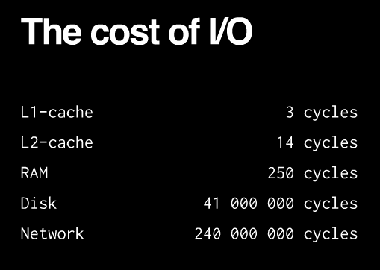
I/O IS SLOW

Slide 15
BLOCKING VS NON-BLOCKING I/O
const fs = require('fs');
​
let callback = (err, file) => console.log(file);
fs.readFile('./file1', callback);
fs.readFile('./file2', callback);
const fs = require('fs');
​
console.log(fs.readFileSync('./file1'));
console.log(fs.readFileSync('./file2'));
0s
5s
10s
Blocking
file1
file2
Non-blocking
file1
file2

Slide 16
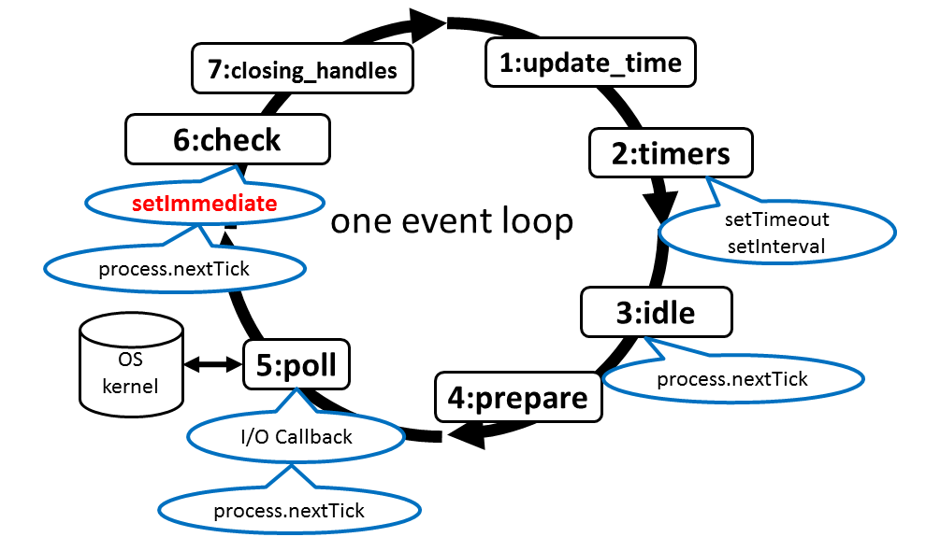
EVENT LOOP

Slide 17
CALLBACK
PATTERN

Slide 18
CALLBACK PATTERN
In JavaScript, a callback is a function that is passed as an argument to another function and is invoked with the result when the operation completes.
function add(a, b, callback) {
callback(a + b);
}
function add(a, b, callback) {
setTimeout(() => callback(a + b), 0);
}
function add(a, b) {
return a + b;
}

Slide 19
CALLBACK CONVENTION
Callback come last
Error in callback come first

Slide 20
CALLBACK PATTERN
const fs = require('fs');
​
function readJSON(filename, callback) {
fs.readFile(filename, 'utf8', (err, data) => {
let parsed;
if (err) {
return callback(err);
}
try {
parsed = JSON.parse(data);
} catch (err) {
return callback(err);
}
callback(null, parsed);
});
}

Slide 21
MODULE SYSTEM

Slide 22
MODULE SYSTEM
Modules are the bricks for structuring non-trivial applications, but also the main mechanism to enforce information hiding by keeping private all the functions and variables, that are not explicitly marked to be exported
Node.js built module system on top of CommonJS modules.

Slide 23
MODULE TYPES
.js modules
.json modules
.node modules(C++)

Slide 24
MODULE API
require()
object module
module.exports
module.exports = exports = this

Slide 25
MODULE CACHING
Each module is only loaded and evaluated the first time it is required, since any subsequent call of require() will simply return cached version.
The module cache is exposed via the require.cache variable, so it is possible to directly access it if needed.

Slide 26
MODULE SYSTEM
DEMO

Slide 27
GLOBAL OBJECTS
Global scope:
Module scope:
global
console
process
timers
__dirname
__filename
module
exports
require()

Slide 28
EVENT
EMITTER

Slide 29
EVENT EMITTER
All objects that emit events are instances of the EventEmitter class.
When the EventEmitter object emits and event, all of the functions attached to that specific event are called synchronously.

Slide 30
EVENT EMITTER API
on(eventName, listener)
once(eventName, listener)
emit(eventName[, …args])
removeListener(eventName, listener)
listeners(eventName)

Slide 31
ERROR EVENTS
const EventEmitter = require('events');
​
const emitter = new EventEmitter();
​
emitter.on('error', err => console.log(err));
​
emitter.emit('error', new Error('whoops!'));
// add ‘error’ listener to prevent crash process
const EventEmitter = require('events');
​
const emitter = new EventEmitter();
​
emitter.emit('error', new Error('whoops!'));
// emit 'error' without handler will crash process

Slide 32
MEMORY LEAKS
const EventEmitter = require('events');
​
const emitter = new EventEmitter();
​
function Request() {
emitter.on('data', console.log); // memory leak!!!
}
​
setInterval(() => {
let req = new Request();
}, 200);

Slide 33
EVENT EMITTER
DEMO

Slide 34
CORE UTILITY
MODULES

Slide 35
CORE UTILITY MODULES
path
url
querystring
util
process
console

Slide 36
PATH
The path module provides utilities for working with file and directory paths.
path.parse(path)
path.format(pathObject)
path.join([…path])
path.normalize(path)
path.isAbsolute(path)

Slide 37
URL & QUERYSTRING
The url and querystring modules provide utilities for URL resolution and parsing.
url.parse(url)
url.format(urlObject)
querystring.escape(str)
querystring.unescape(str)
querystring.parse(str)
querystring.stringify(str)

Slide 38
UTIL
The util module provide useful utilities for application and modules developers.
util.inspect(obj)
util.inherits(constructor, superConstructor)
util.deprecate(func, string)
util.promisify(origFunc)

Slide 39
PROCESS
The process object is a global that provides information about, and control over, the current Node.js process.
Properties:
Methods:
env
argv
stdout
stderr
stdin
cwd()
memoryUsage()
nextTick()
exit(code)

Slide 40
CONSOLE
The console module provides a simple debugging console that is similar to the JavaScript console mechanism provided by web browsers.
new Console(output, errorOutput)
log / info (data)
error / warn (data)
time(label)
timeEnd(label)
global.console = new Console(process.stdout, process.stderr);

Slide 41
File
System

Slide 42
FILE SYSTEM
Node.js implements File I/O using simple wrappers around standard POSIX functions.
All methods in fs module have:
asynchronous form
synchronous form

Slide 43
ASYNC VS SYNC
let fs = require('fs');
​
// async
fs.readFile(__filename, {encoding: 'utf8'}, (err, data) => {
if (err) throw err;
console.log(data);
});
​
// sync
let data = fs.readFileSync(__filename, {encoding: 'utf8'});
console.log(data);

Slide 44
FILE SYSTEM
DEMO

Slide 45
HTTP

Slide 46
HTTP
The HTTP interface in Node.js are designed to support many features of the protocol which have been traditionally difficult to use. The interface is careful to never buffer entire request or responses – the user is able to stream data.
Node.js HTTP API is very low-level. It deal with stream handling and message parsing only. It parses a message into headers and body but is does not parse the actual headers or the body.

Slide 47
HTTP
HTTP Server
HTTP Client

Slide 48
HTTP SERVER
http.createServer(requestHandler)
new http.Server(requestHandler)
Methods :
Events:
listen(port, callback)
close()
request

Slide 49
SIMPLE HTTP SERVER
const {Server} = require('http');
​
const server = new Server((req, res) => {
// req -> http.IncomingMessage
// res -> http.ServerResponse
res.writeHead(200, {'Content-Type': 'text/plain'});
res.end('Hello World\n');
});
​
server.listen(3000, () => {
console.log('http://localhost:3000/')
});

Slide 50
INCOMING MESSAGE
method
url
headers
statusCode
statusMessage
http.IncomingMessage is Readable Stream.

Slide 51
SERVER RESPONSE
Properties:
Methods:
statusCode
statusMessage
setHeader(name, value)
write(chunk)
end()
http.ServerResponse is Writable Stream.

Slide 52
HTTP SERVER
DEMO

Slide 53
HTTP CLIENT
http.request(options, responseHandler)
http.get(options, responseHandler)

Slide 54
SIMPLE HTTP REQUEST
const http = require('http');
​
http.get('http://google.com/', (res) => {
let rawData = '';
​
console.log(`Status code: ${res.statusCode}`);
console.log(`Content-type: ${res.headers['content-type']}`);
​
res.setEncoding('utf8');
res.on('data', (chunk) => rawData += chunk);
res.on('end', () => {
console.log(rawData);
});
});

Slide 55
HTTP CLIENT
DEMO

Slide 56

THANK YOU!

